Slide 1
TOP-DEFENSE CLASS 3 DOCUMENT
MM27 PROTOCOL
DIY MICROSCOPY
20.02.2021
MISSION CONFIDENTIELLE

Slide 2
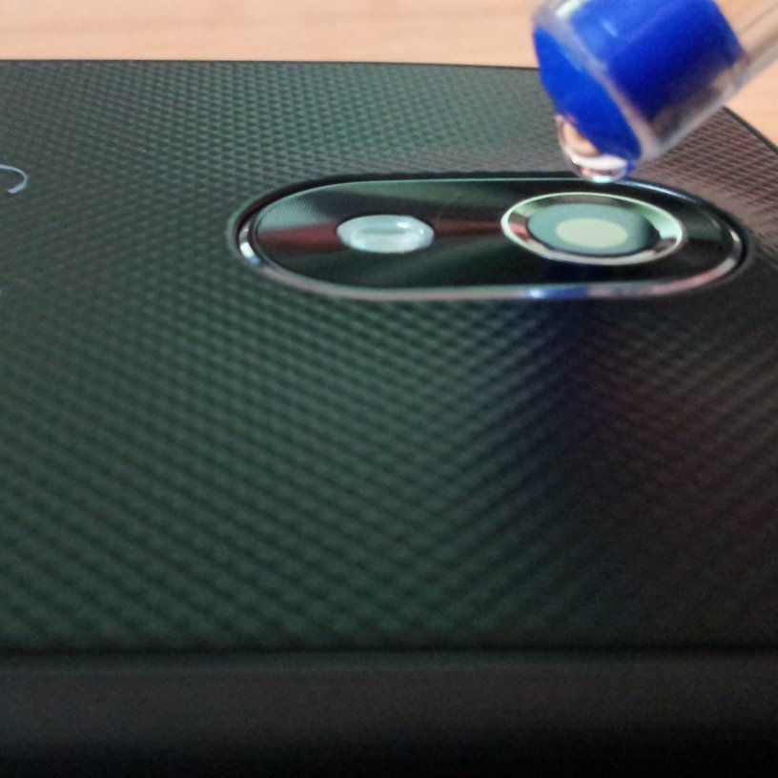
MM27 PROTOCOLE DIY MICROSCOPY
The MM27 protocol is deployed when an operational team needs help to manufacture a microscope in a frugal way.
Hardware: a smartphone and some water.
Objective: provide the operational team with a simple and robust protocol that allows a smartphone to be used as a microscope by placing a drop of water on its camera.
Criteria: the devices must be as reliable as possible.
07.05.2021
MISSION CONFIDENTIELLE

Slide 3
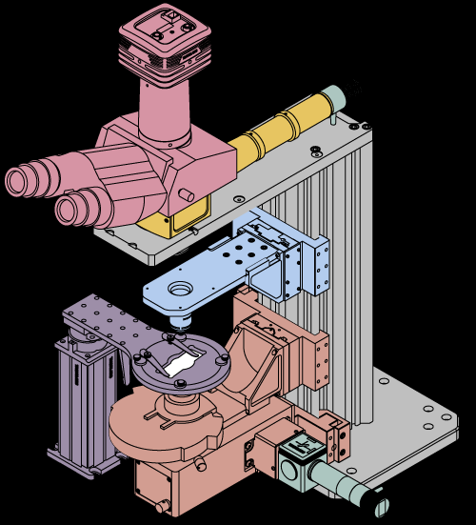
MM27 PROTOCOLE DIY MICROSCOPY
Before proposing the protocol to the field agent, it is necessary to characterize a few different commercial smartphone models. For this, it will be necessary:
measure the magnification due to the drop (by finding the same way to measure it on the different smartphones, for example by magnifying an object of known size)
measure the effect of the size of the drop of water as precisely as possible
develop the most efficient sample holder possible with frugal means
make an illustrated instruction manual
07.05.2021
MISSION CONFIDENTIELLE

Slide 4
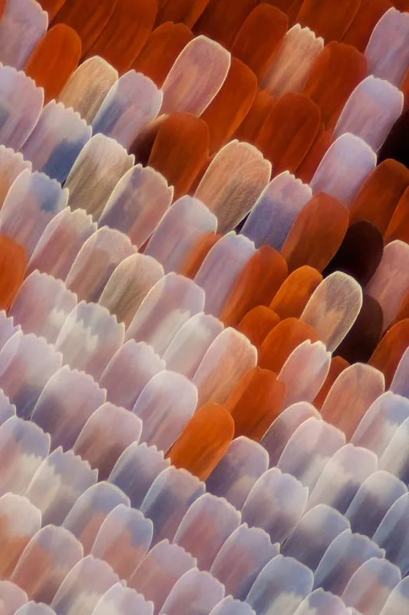
MM27 PROTOCOLE DIY MICROSCOPY
The support team will follow a "collaborative mode" procedure by working in multiple teams :
1. The teams agree on how to measure the magnification of their device, in order to have a common criterion. Then they move in parallel.
2. An official test of the devices is then organised. For this, the teams agree on an object to photograph (a detail of a banknote for example), and have a limited time to take the photo..
3. The protocols and instructions for use and photos taken are sent to the operational team, who can choose.
07.05.2021
MISSION CONFIDENTIELLE

