Slide 1
TOP-DEFENSE CLASS 3 DOCUMENT
GH12 PROTOCOL
GENTLE FALL
20.02.2021
MISSION CONFIDENTIELLE

Slide 2
GH12 PROTOCOL GENTLE FALL
The GH12 protocol aims to determine the best possible device to ensure the fall of a fragile object in response to the needs expressed by an operational team (in the field).
Hardware : the support team must invent a system using only equipment from the C2309 operational kit available to the operational team.
Object to protect: as specified by the operational team.
Drop height : as specified by the operational team
Additional constraint : as specified by the operational team
20.02.2021
MISSION CONFIDENTIELLE

Slide 3
GH12 PROTOCOL GENTLE FALL
Support team will follow a "competition mode" procedure working in multiple shifts:
1. Each team designs a protection system and tests it to improve it as much as possible. It must also produce a construction guide for the operational team.
2. An official test of the devices is then organized. All devices must be tested in real conditions, the fragile object is replaced by an egg which must survive the fall.
20.02.2021
MISSION CONFIDENTIELLE

Slide 4
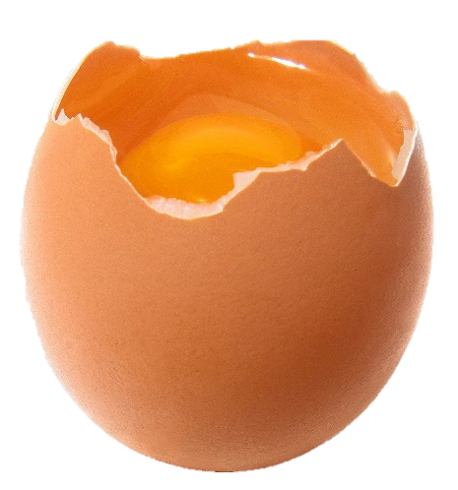
GH12 PROTOCOL GENTLE FALL
3. During the official test, the fall time of the devices is measured by video analysis (use the "Fizziq" app), and the importance of air friction is then quantitatively assessed.
4. The support team chooses the most reliable device; its instructions for use and the estimation of air friction are sent to the operational team.
20.02.2021
MISSION CONFIDENTIELLE

