Slide 1
TOP-DEFENSE CLASS 3 DOCUMENT
AR22 PROTOCOL
Light Communication
20.02.2021
CONFIDENTIAL ASSIGNMENT

Slide 2
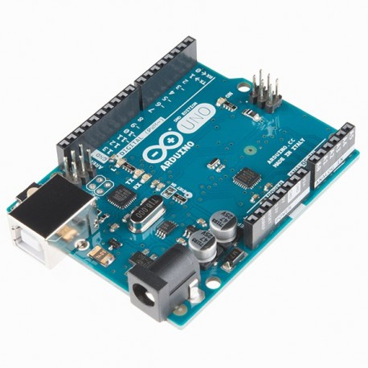
LIGHT COMMUNICATION PROTOCOL
The AR22 protocol must be implemented when an operational team needs help to manufacture a light communication device.
Hardware: the support team must use the standard Arduino kit.
Objective: to provide the operational team with a simple and robust protocol for communicating with light. The device must be able to emit a signal and pick up a response. Other constraints may be issued by the operational team.
Criteria: the devices must be as reliable as possible.
07.05.2021
CONFIDENTIAL ASSIGNMENT

Slide 3
LIGHT COMMUNICATION PROTOCOL
The support team will follow a "competition mode" procedure working in multiple teams:
Each team designs a protection system and tests it to improve it as much as possible. It must also produce a user manual for the operational team.
An official test of the devices is then organised. All devices must be tested in real conditions: a message of 3 letters is given which must be sent and detected correctly.
The support team chooses the most reliable device and its instructions are sent to the operational team.
07.05.2021
CONFIDENTIAL ASSIGNMENT

