Slide 1
TOP-DEFENSE CLASS 3 DOCUMENT
PROTOCOLE YT98
OUTREACH VIDEOS
20.02.2021
MISSION CONFIDENTIELLE

Slide 2
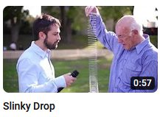
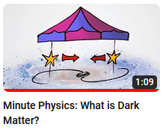
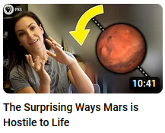
YT98 PROTOCOL OUTREACH VIDEOS
Objective: provide the agent with a protocol for making a scientific tool via a mainstream Youtube video that will not be spotted by the enemy.
Hardware: Use your smartphone to shoot the video.
Criteria: the video must look as much as possible like a popularization video like a popular Youtube channel (Veritasium, AsapScience, Smarter Everyday, ...) or a tutorial in Do-It-Yourself mode.
07.05.2021
MISSION CONFIDENTIELLE

