Slide 1

TOP-DEFENSE CLASS 3 DOCUMENT
PZ29 PROTOCOL
Acoustic Signature Authentication
20.02.2021
MISSION
CONFIDENTIELLE

Slide 2
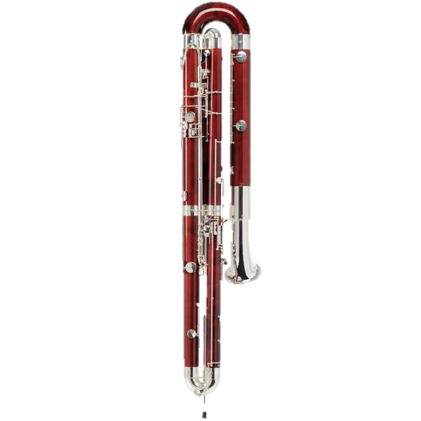
PROTOCOL ACOUSTIC SIGNATURE AUTHENTICATION
Objective: provide the agent with a protocol for the manufacture of original musical instruments with the acoustic signature of the produced notes. The agent can then use it with his contact to authenticate the messages received.
Hardware: Use everyday materials. The use of electronic equipment is prohibited except to analyze the signals.
Criteria: the instruments invented must be as reproducible as possible but sufficiently original so that they cannot be copied by usual instruments.
07.05.2021
MISSION
CONFIDENTIELLE

Slide 3
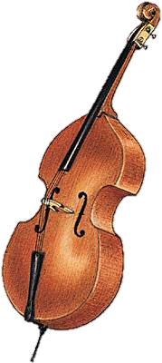
PROTOCOL ACOUSTIC SIGNATURE AUTHENTICATION
The gitech will follow a multi-test procedure to promote diversity of solutions.
Teams must make instruments to generate 26 different notes, which the teams divide among themselves as they wish. The instruments must be as different as possible to strengthen the security of authentication
For each instrument, the agent must be provided with a protocol explaining how to make it (photos allowed). It will also be necessary to provide an acoustic characterization which specifies how to recognize this instrument compared to others from its spectrum..
07.05.2021
MISSION
CONFIDENTIELLE

Slide 4
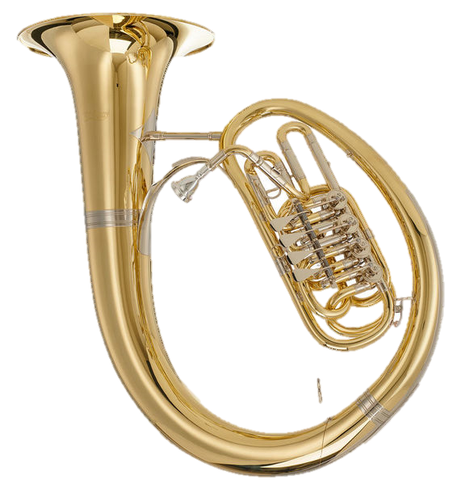
PROTOCOL ACOUSTIC SIGNATURE AUTHENTICATION
An official test of the devices will be organized by the management of GITECH. To check the quality of the invented instruments, each team will have to use their instruments live to play a known melody of a few notes.
If the other teams manage to recognize the melody, it is a sign of the acoustic quality of the instruments.
07.05.2021
MISSION
CONFIDENTIELLE

