Slide 1

TOP-DEFENSE CLASS 3 DOCUMENT
PZ99 PROTOCOL
Measurement and exploration tools
20.02.2021
MISSION
CONFIDENTIELLE

Slide 2
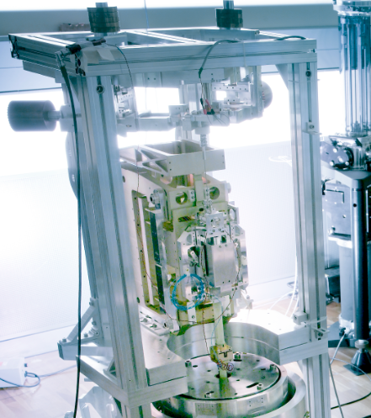
PZ99 PROTOCOL
MEASUREMENT AND EXPLORATION TOOLS
The PZ99 protocol must be implemented when an operational team needs help to manufacture measurement and exploration tools.
Hardware: the support team must use the equipment available to the operational team.
Objective: provide the operational team with a simple and robust protocol for manufacturing measurement and exploration instruments. Other constraints may be issued by the operational team.
Criteria: the instruments must be as reliable as possible.
07.05.2021
MISSION
CONFIDENTIELLE

Slide 3
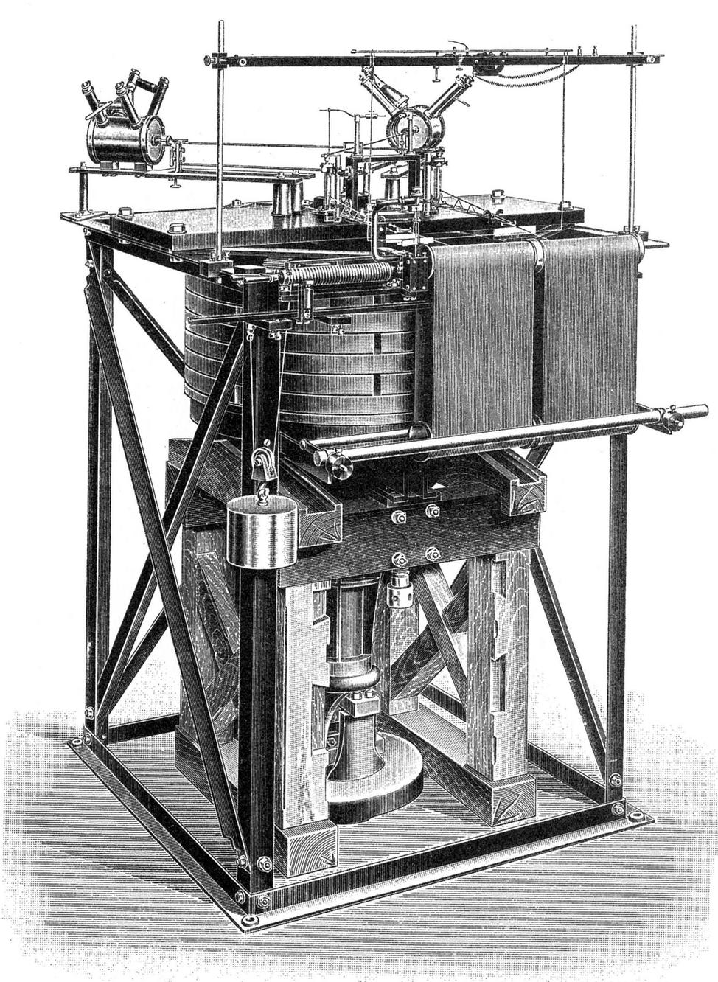
PZ99 PROTOCOL
MEASUREMENT AND EXPLORATION TOOLS
Standard measurement and exploration tools :
Seismograph: detects and measures ground vibrations.
Anemometer: measures the intensity of the wind. If possible, the anemometer should be calibrated, and indicate the direction.
Luxmeter: measures light intensity. If possible, the light intensity is measured according to the angle that the sensor makes with the horizon.
Magnetometer: measures the magnetic field. If possible, it should be accompanied by a procedure to eliminate the contribution of stray magnetic fields generated by the device itself, as well as a calibration procedure.
07.05.2021
MISSION
CONFIDENTIELLE

Slide 4
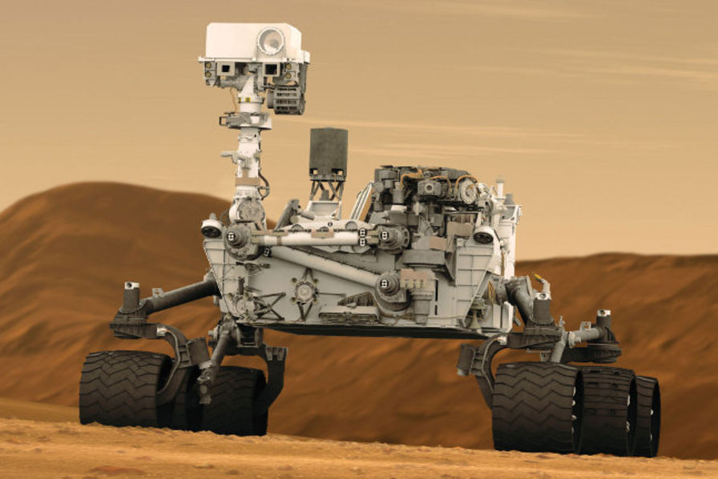
PZ99 PROTOCOL
MEASUREMENT AND EXPLORATION TOOLS
Technical support will follow a "collaborative mode" procedure by working in multiple teams:
1. The teams divide up the various tools to be designed, each being responsible for the development and the associated documents. They should help each other when needed..
2. An official test of the devices is then organised. All devices must be tested under realistic conditions, taking into account the constraints issued by the operational team.
3. The protocols and instructions for use are sent to the operational team.
07.05.2021
MISSION
CONFIDENTIELLE

