Slide 1


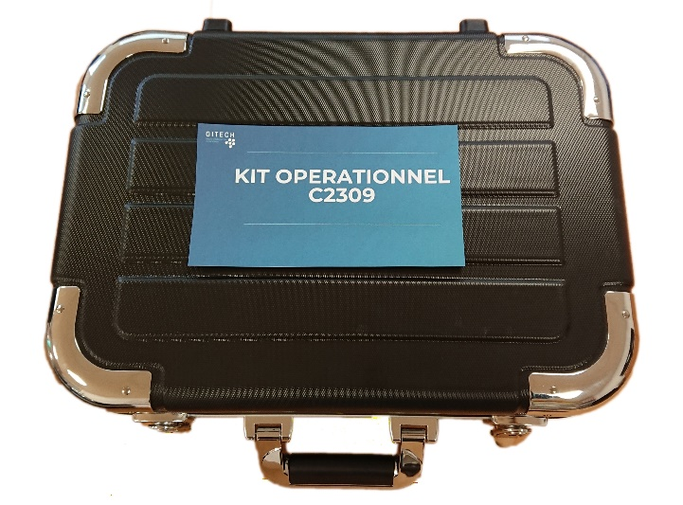
KIT C2309
10 A4 sheets
duct tape
Cutter
Scissors
30cm ruler
2 cardboard sheets
String
Balloon
Plastic bag
electrician tape
modeling clay
5 cups
Aluminum foil
Garbage bags
4 thin wooden rods
bubble wrap
2 long rubber bands
10 short rubber bands
thick iron wire
plastic self-locking ties
Patafix
20 straws
1 survival blanket

