Slide 1
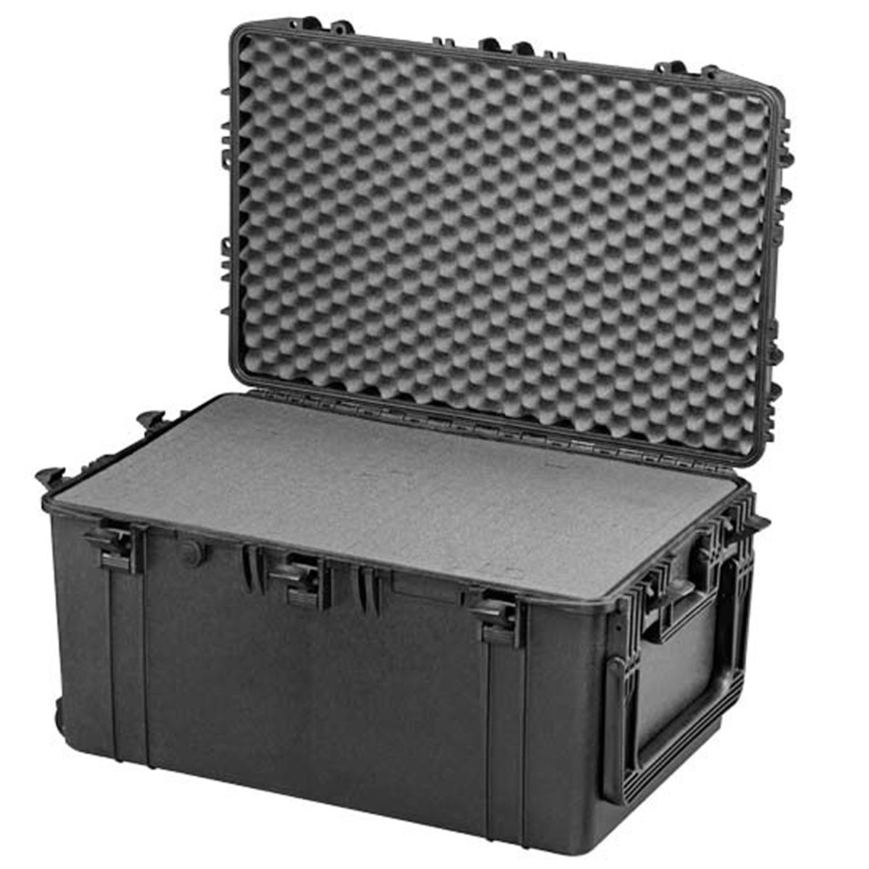
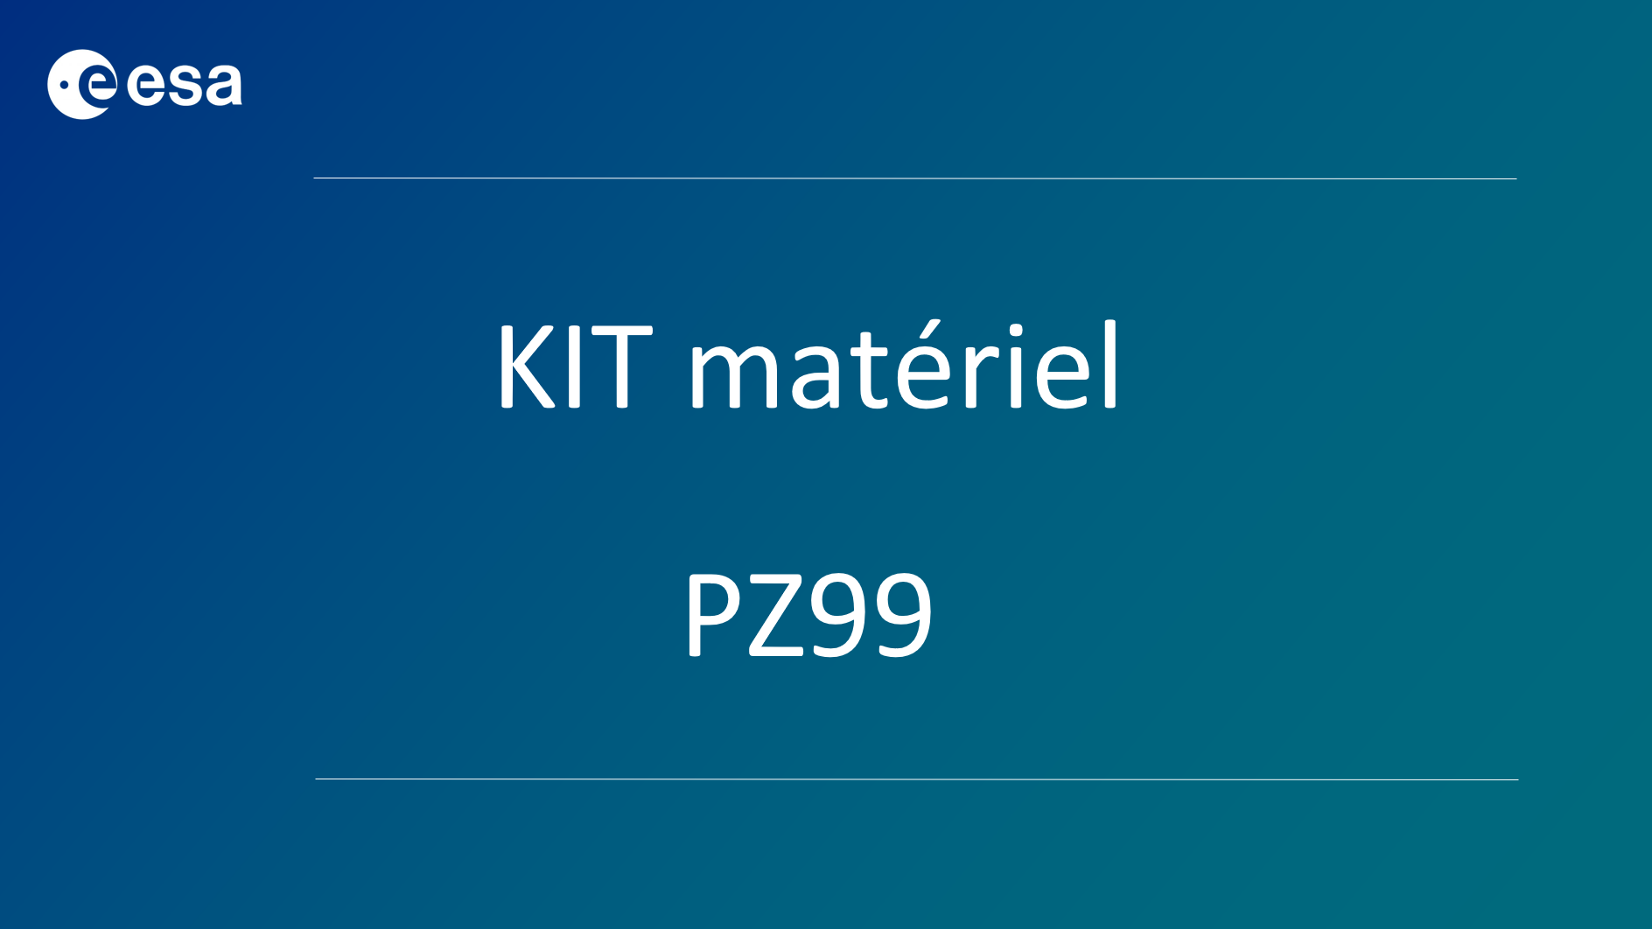
KIT OPERATIONNEL PZ99
10 A4 sheets
duct tape
Cutter
Scissors
30cm ruler
2 cardboard sheets
String
Balloon
Plastic bag
electrician tape
modeling clay
5 cups
1 K800 glue gun4 glue sticks
10 magnets Q-10-10-05-N
5 magnets S-20-02-N
10 transparent plastic sheets
1 mass of 100g
Aluminum foil
Garbage bags
4 thin wooden rods
bubble wrap
2 long rubber bands
10 short rubber bands
thick iron wire
plastic self-locking ties
Patafix
20 straws
1 survival blanket
2 plastic tubes 1 m long, 8 mm in diameter
20 wooden rods, 30 cm long, 3 mm in diameter

